Slide 1

SuperResAI:
Image Super-Resolution ML Project
North South University – Dept. of ECE
By: Atique S. Chaklader, Samiyeel A. Binaaf, Md. Mubtasim Fuad, Md. Tamjid Islam
Supervisor: Dr. Mohammad Shifat-E-Rabbi

Slide 2
Introduction to Super-Resolution
Image resolution is paramount in today's digital landscape, from medical imaging to satellite surveillance. Our goal is to precisely reconstruct high-resolution (HR) images from their low-resolution (LR) counterparts, enhancing clarity and detail.
The Challenge
Our Solution
Impact
Transforming pixelated LR images into sharp, visually rich HR versions.
Leveraging Deep Learning, specifically the Enhanced Deep Super-Resolution (EDSR) model, to achieve superior results.
Outperforming traditional methods by generating visually superior and quantitatively better images.

Slide 3



SuperResAI Workflow: From Data to Results
Our methodology follows a rigorous pipeline ensuring robust model training and reliable evaluation.
1. Dataset Preparation
2. Model Training
3. Evaluation
We preprocess diverse image datasets to create consistent HR (256×256) and LR (64×64) pairs. Data is split into training (60%), validation (20%), and testing (20%) sets to ensure model generalization. This is handled by 1_prepare_dataset.py.
The EDSR model (scale factor ×4) with a Pixel Shuffle–based upsampling module. We use MSE loss, Adam optimizer, and PSNR as the primary metric.
Post-training, the model's performance is rigorously evaluated using quantitative metrics: PSNR (Peak Signal-to-Noise Ratio) and SSIM (Structural Similarity Index Measure). Crucially, we conduct visual comparisons between LR, super-resolved (SR), and ground-truth HR images.

Slide 4
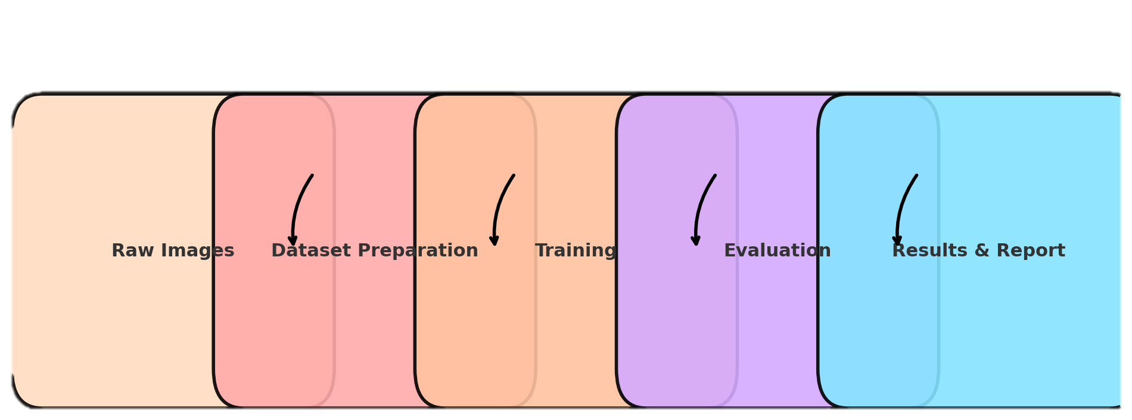
Super-Resolution Workflow Diagram
This diagram illustrates the complete workflow, from initial low-resolution input through the EDSR network to the final high-resolution output. It highlights the integration of our deep learning model within the image super-resolution pipeline.

Slide 5

Understanding Bicubic Interpolation
Bicubic interpolation is a classical signal processing technique used for image resizing. It's an upgrade from simpler methods like nearest-neighbor or bilinear interpolation, producing smoother results by considering a larger neighborhood of pixels.
How it Works
It estimates new pixel values by applying a weighted average of the 16 nearest surrounding pixels (a 4x4 kernel) in the original image. This involves fitting a cubic polynomial to these points.
Limitations
While it smooths out jagged edges, it cannot synthesize new, authentic details. The resulting images often appear soft or blurry, lacking the crispness achievable with data-driven deep learning approaches.

Slide 6
The EDSR Model Architecture
Our SuperResAI solution is built upon EDSR (Enhanced Deep Super-Resolution), a deep residual network that removes batch normalization and uses residual scaling for stable, high-accuracy training. Its key innovation lies in performing feature extraction directly on the low-resolution input, then upscaling in a single step.
Based on Residual Networks (ResNet):
Uses multiple residual blocks to learn image features.
Removes batch normalization (BN) layers to reduce artifacts and improve accuracy.
Deep & Wide Architecture:
Much deeper than previous SR models like SRCNN, VDSR.
Uses wider layers with more feature maps for better detail learning.
Residual Scaling:
To stabilize training, the residual outputs are scaled by a constant (e.g., 0.1).
Up sampling Module:
Uses sub-pixel convolution (pixel shuffle) for efficient image upscaling.

Slide 7
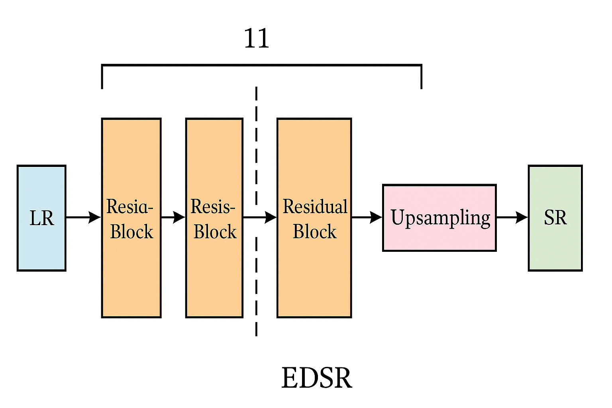
EDSR Architecture at a Glance
This visual representation breaks down the EDSR model, emphasizing its compact convolutional layers and the innovative Pixel Shuffle operation. Note how the model operates on the lower-resolution feature space before the final upscaling, contributing to its efficiency.

Slide 8


Bicubic vs. EDSR: A Comparative Look
Comparing EDSR with traditional Bicubic interpolation highlights the impact of deep learning in image enhancement.
Bicubic Interpolation
EDSR (SuperResAI)
Traditional, mathematical approach.
Modern, deep learning approach.
Adds smoothness, but no new details.
Learns to synthesize realistic new details.
Quantitative Results:
Quantitative Results:
PSNR: 24.58 dB
PSNR: 28.92 dB
SSIM: 0.763
SSIM: 0.885
The quantitative metrics demonstrate a significant improvement, with EDSR achieving a nearly 4.5 dB increase in PSNR and a substantial boost in SSIM, indicating higher perceptual quality.

Slide 9
Quantitative Performance: A Clear Advantage
The numbers speak volumes about SuperResAI's effectiveness.
24.58dB
0.763
Bicubic PSNR
Bicubic SSIM
PSNR: Peak Signal-to-Noise Ratio. Higher values indicate better image quality. Bicubic's score serves as a baseline for comparison.
SSIM: Structural Similarity Index Measure. Closer to 1 implies higher structural similarity to the original image.
28.92dB
0.885
SuperResAI (EDSR) PSNR
SuperResAI (EDSR) SSIM
SuperResAI achieves a significantly higher PSNR, demonstrating its superior ability to reconstruct image fidelity.
The SSIM score for SuperResAI is also markedly higher, indicating that it preserves structural information and visual quality much more effectively than Bicubic.
→ The EDSR model employed in SuperResAI consistently and significantly outperforms the Bicubic baseline across key metrics.

Slide 10

Result

Slide 11
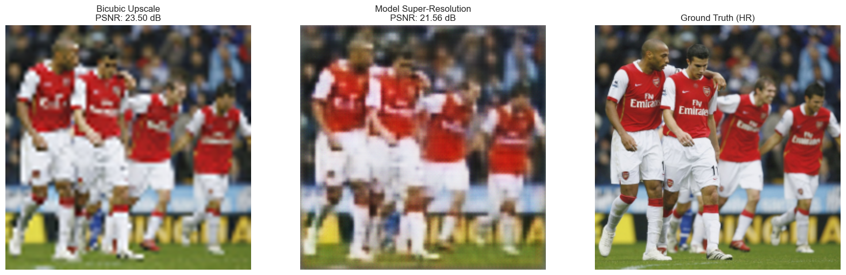
Result

Slide 12

Result

Slide 13
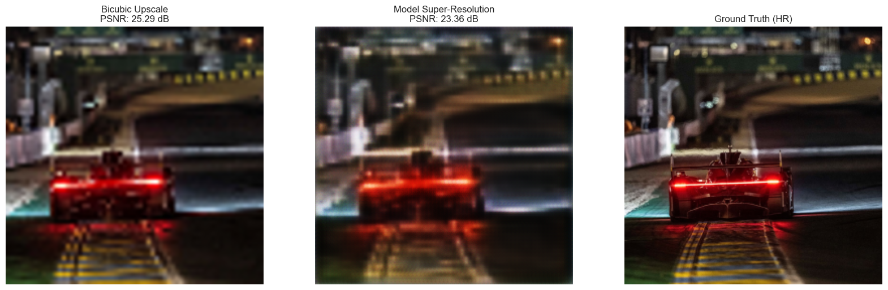
Result

Slide 14


Qualitative Analysis: Visualizing Enhanced Fidelity
Our qualitative analysis reveals significant improvements in image reconstruction, offering a visually superior experience compared to traditional methods.
Sharper Edges & Clearer Textures: Images processed with SuperResAI exhibit markedly defined edges and enhanced texture clarity, bringing subjects into vivid focus.
Accurate Fine Detail Reconstruction: The system excels at correctly reconstructing intricate details, such as the subtle patterns in fabric or the complex structures found in natural landscapes, preserving authenticity.
Alignment with Metric Improvements: The observable visual quality directly correlates with improved quantitative metrics like Peak Signal-to-Noise Ratio (PSNR) and Structural Similarity Index (SSIM), validating our qualitative observations.

Slide 15
Charting the Future: Overcoming Limitations and Expanding Horizons
Current Limitations
Future Enhancements
Unseen Patterns & Textures
Deeper Networks & Attention Mechanisms: Implementing more complex network architectures and attention mechanisms to capture broader contextual information.
Occasional struggles with unseen patterns or highly complex textures not present in the training data.
GAN-based Super-Resolution: Exploring Generative Adversarial Networks (GANs), such as SRGAN, to produce even more photorealistic textures.
Dataset Size Constraints
Performance can be influenced by the size and diversity of the current training dataset.
Robustness Training: Training the model with diverse noise, blur, and compression artifacts to improve real-world applicability.
User-Friendly GUI: Developing an intuitive graphical user interface to make SuperResAI accessible to a wider audience, beyond researchers and engineers.

Slide 16



Conclusion: A Foundation for Advanced Image Restoration
Proven Effectiveness
Superior Performance
Strong Qualitative Results
SuperResAI effectively demonstrates the power of EDSR-based super-resolution, providing a robust solution for image enhancement.
It delivers significant improvements over traditional Bicubic interpolation in both PSNR and SSIM metrics, underscoring its technical superiority.
The visually appealing results confirm its ability to produce clearer, more detailed images, setting a strong foundation for future advancements in image restoration.
We are confident that SuperResAI will serve as a valuable tool and a stepping stone for further innovation in the field of image processing and computer vision.

